Slide 2


Slide 3


Slide 4


X

Slide 5


Combinatorics
Factorials, Permutations, and Combinations
X

Slide 6
Combinatorics
Combinatorics is often referred to as the “study of counting”.
X

Slide 7
Combinatorics
Combinatorics is often referred to as the “study of counting”.
You may be wondering:
“Study counting?!? That’s easy: 1, 2, 3, 4, etc… Problem solved! What is there to study?”

Slide 8
Combinatorics
Combinatorics helps us count things when the results may not be immediately clear.
Many real life business challenges and data science decisions are directly related to the ability to count possible combinations or permutations of objects.

Slide 9
Combinatorics
We can use combinatorics to address real business questions:

Slide 10
Combinatorics
We can use combinatorics to address real business questions:
For a subscription box company, how many possible combinations of products are there that can be delivered to a customer?

Slide 11
Combinatorics
We can use combinatorics to address real business questions:
For a feedback survey, how many different feedback scores are possible for a given number of questions with each reporting 1-5 star ratings?

Slide 12
Combinatorics
We can use combinatorics to address real business questions:
For an online marketplace, how many combinations of products are possible within a customer’s budget?

Slide 13
Combinatorics
We can use combinatorics to address real business questions:
For an food delivery business, how many different possible order combinations can be created given a certain subset of possible food items?

Slide 14
Combinatorics
We can use combinatorics to address real business questions:
Using the power of factorials, permutations, and combinations we can directly find answers to these questions!

Slide 15
Combinatorics
In this section of the course, we’ll be exploring three key ideas in combinatorics that can have direct applications to business scenarios:
Factorials
Permutations
Combinations

Slide 16
Combinatorics
Let’s quickly explore these three concepts before diving deeper into the details and getting some practice with them!

Slide 17
Combinatorics
Factorial:
In mathematics, the factorial is an operation on a non-negative integer n (denoted by n!) that is equal to the product of all positive integers less than or equal to n.

Slide 18
Combinatorics
Factorial: Product of all positive integers less than or equal to n.

Slide 19
Combinatorics
Factorial: Product of all positive integers less than or equal to n.

Slide 20
Combinatorics
Factorial: Product of all positive integers less than or equal to n.

Slide 21
Combinatorics
Factorial: Product of all positive integers less than or equal to n.

Slide 22
Combinatorics
Factorial: Product of all positive integers less than or equal to n.

Slide 23
Combinatorics
Factorial: Product of all positive integers less than or equal to n.

Slide 24
Combinatorics
Factorial: Product of all positive integers less than or equal to n.

Slide 25
Combinatorics
Factorial: Product of all positive integers less than or equal to n.

Slide 26
Combinatorics
Factorial: Product of all positive integers less than or equal to n.

Slide 27

Combinatorics
Factorial: Product of all positive integers less than or equal to n.

Slide 28
Combinatorics
Factorial: Product of all positive integers less than or equal to n.

Slide 29
Combinatorics
Factorial: Product of all positive integers less than or equal to n.

Slide 30
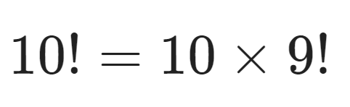
Combinatorics
Factorial: Product of all positive integers less than or equal to n.

Slide 31
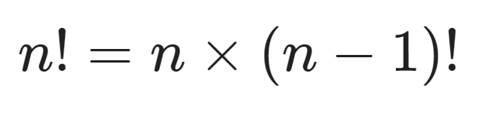
Combinatorics
Factorial: Product of all positive integers less than or equal to n.

Slide 32
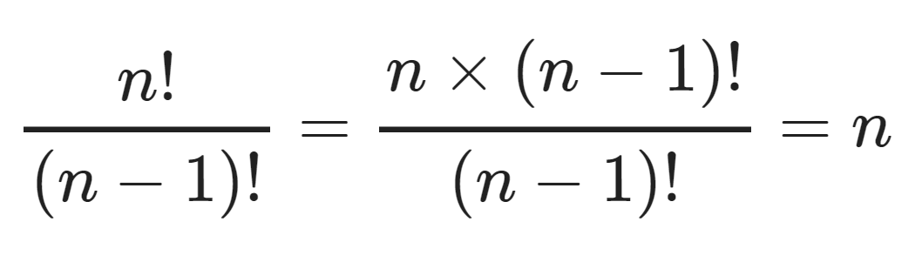
Combinatorics
Factorial: Product of all positive integers less than or equal to n.

Slide 33
Combinatorics
Factorial: Product of all positive integers less than or equal to n.

Slide 34
Combinatorics
Factorial: Product of all positive integers less than or equal to n.

Slide 35
Combinatorics
Factorial: Product of all positive integers less than or equal to n.

Slide 36
Combinatorics
Factorial:
Understanding the mathematics of factorials allows us to calculate permutations and combinations.
Let’s explore permutations in more detail.

Slide 37
Combinatorics
Permutation:
A permutation of a set of objects is an arrangement of the objects in a certain order.
This means we can calculate all the possible arrangements (permutations) of a set of objects.

Slide 38
Combinatorics
Permutation:
For example, imagine ordering 3 items from Amazon that will be delivered on separate days.
How many permutations are there of the order of their arrivals?

Slide 39
Combinatorics
Permutation: How many permutations of the order of arrival of these 3 items?
Imagine items are a, b, and c:

Slide 40
Combinatorics
Permutation: How many permutations of the order of arrival of these 3 items?
Imagine items are a, b, and c:
abc

Slide 41
Combinatorics
Permutation: How many permutations of the order of arrival of these 3 items?
Imagine items are a, b, and c:
abc
bac

Slide 42
Combinatorics
Permutation: How many permutations of the order of arrival of these 3 items?
Imagine items are a, b, and c:
abc
bac
acb
bca
cab
cba

Slide 43
Combinatorics
Permutation: How many permutations of the order of arrival of these 3 items?
For simple examples like this one, the number of possible permutations is simply n!.
Thus the order of delivery of 3 items can be delivered in 6 different permutations, which is equal to 3!.

Slide 44
Combinatorics
Permutation:
There are other considerations for permutations, such as the number of permutations possible for a subset of items or permutations that allow for repetition, such as license plates.

Slide 45
Combinatorics
Permutation:
Permutation calculations were even used as part of a solution during World War II by the Allies to estimate the number of tanks being manufactured by Germany simply based on the sampling of the serial numbers of different tank parts.

Slide 46
Combinatorics
Combinations:
A combination is an unordered selection of objects. For example, a group of people chosen from a group of people for a baseball team. You could also have combinations that allow for repetition, for example a pizza with 2x pepperoni and cheese.

Slide 47
Combinatorics
Combinations:
Notice how unlike permutations, order doesn’t matter here. So the combination abc is the same combination as cba. The permutation abc is not the same as the permutation cba.

Slide 48
Combinatorics
Combinations:
Calculating combinations also makes use of factorials and has its own notation.

Slide 49
Combinatorics
Combinations:
Count for number of combinations from a set of n objects taken k a time.

Slide 50
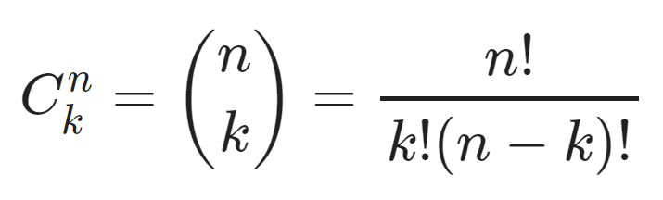
Combinatorics
Combinations:
Count for number of combinations from a set of n objects taken k a time.

Slide 51
Combinatorics
Combinations:
For example, imagine a consumer dog toy box company that delivers boxes with 5 dog toys out of their selection of 20 dog toys.

Slide 52
Combinatorics
Combinations:
For example, imagine a consumer dog toy box company that delivers boxes with 5 dog toys out of their selection of 20 dog toys.

Slide 53
Combinatorics
Combinations:
For example, imagine a consumer dog toy box company that delivers boxes with 5 dog toys out of their selection of 20 dog toys.

Slide 54
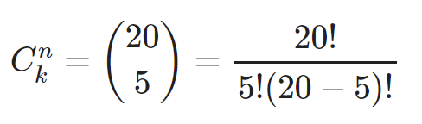
Combinatorics
Combinations:
For example, imagine a consumer dog toy box company that delivers boxes with 5 dog toys out of their selection of 20 dog toys.

Slide 55
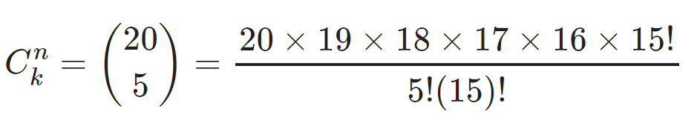
Combinatorics
Combinations:
For example, imagine a consumer dog toy box company that delivers boxes with 5 dog toys out of their selection of 20 dog toys.

Slide 56
Combinatorics
Combinations:
For example, imagine a consumer dog toy box company that delivers boxes with 5 dog toys out of their selection of 20 dog toys.

Slide 57
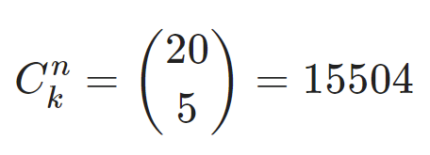
Combinatorics
Combinations:
For example, imagine a consumer dog toy box company that delivers boxes with 5 dog toys out of their selection of 20 dog toys.

Slide 58
Combinatorics
Understanding factorials, permutations, and combinations has become a key part of creating robust logistics frameworks, since clearly understanding package ordering and combinations can help create efficiencies for customers.

Slide 59
Combinatorics
There are other ideas around permutations and combinations we haven’t discussed yet, for example, what if you allowed the same dog toys to be selected twice for a single delivery package in the previous example?
This is combination with repetition, and follows a different formula.

Slide 60
Combinatorics
In the next few lectures we’ll dive deeper into understanding factorials, permutations and combinations.
Who knew there could be so much to just counting!

